Slide 1

Week 7 Project Update
Matthew Vu

Slide 2
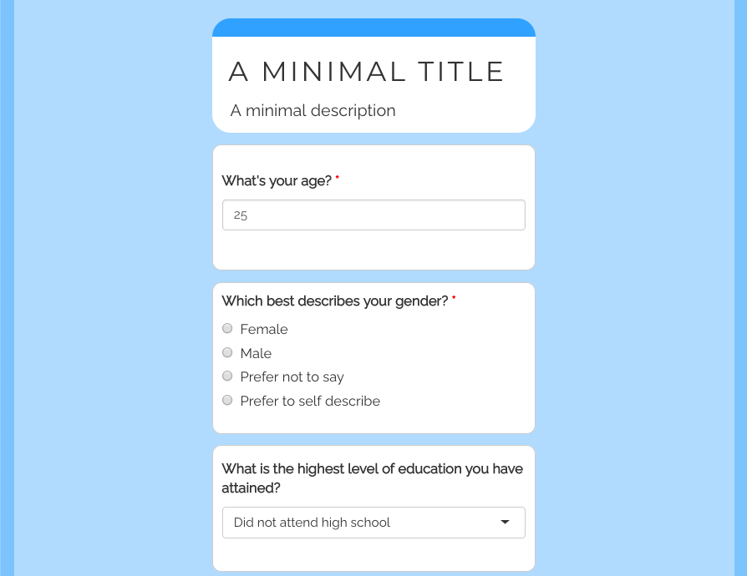
Overall Project Topic and Objective:
The topic of my capstone project is to experiment with several machine learning techniques, such as logistic regression, naïve bayes, support vector machines, k-nearest neighbor, and decisions trees, with the goal of creating a questionnaire application that can predict the risk of diabetes. Also, this capstone project will experiment with clustering the observations using Gower’s distance and Partitioning Around Medoids (PAM) to see if clustering improves model accuracy.
Idea of what the questionnaire should look like using ShinyR. Source: https://cran.r-project.org/web/packages/shinysurveys/vignettes/surveying-shinysurveys.html
Notes:
We use PAM because we have a mix of numerical and cat variables

Slide 3
Research Questions:
1. What behaviors and habits are associated with diabetes risk?
2. What machine learning algorithms out of the following is most effective at predicting diabetes risk: logistic regression, naïve bayes, support vector machines, k-nearest neighbor, and decisions trees
3. Will clustering the data using Gower’s distance and the Partition Around Medoids (PAM) clustering algorithm improve model accuracy?

Slide 4
Updates made this week:
Changed some variables
Finished up variable selection
Split data into training, validation, and test set
Began Modeling

Slide 5

Dataset being used: BFRSS Heath Survey Dataset
Link to Codebook: https://www.cdc.gov/brfss/annual_data/2015/pdf/codebook15_llcp.pdf

Slide 6
Changed two variables to ask more interesting questions
Diabetes_binary = Has diabetes?
HighBP = Has been told they have high blood pressure by a doctor, nurse, or other health professional
HighChol = Has EVER been told by a doctor, nurse or other health professional that their blood cholesterol is high
CholCheck = Has had their cholesterol checked within past five years
BMI = Body mass index
Smoker = Has smoked at least 100 cigarettes in your entire life
Changed to smoker status (current smoker = smokes everyday, current smoker = smokes some days, former smoker, never smoked)
Stroke = Had a stroke
HeartDiseaseorAttack = Had a coronary heart disease or myocardial infarction
PhysActivity = Have done physical activity or exercise during the past 30 days other than their regular job
Changed to amount of physical activity (301+, 1-300, and 0 minutes per week)
Fruits = Consumes fruit one or more times per day
Veggies = Consumes vegetables one or more times per day
HvyAlcoholConsump = Heavy drinkers (adult men having more than 14 drinks per week and adult women having more than 7 drinks per week)
AnyHealthcare = Has any kind of health care coverage, including health insurance, prepaid plans such as HMOs, or government plans such as Medicare, or Indian Health Service
NoDocbcCost = There was a time in the past 12 months when they needed to see a doctor but could not because of cost
GenHlth = General health (Excellent, very good, good, fair, Poor; 1, 2, 3, 4, 5)
MentHlth = How many days during the past 30 days was their mental health not good
PhysHlth = How many days during the past 30 days was their physical health not good
DiffWalk = Has serious difficulty walking or climbing stairs
Sex = Sex
Age = Age category (must be of 18 years or older and categories are organized in increments of 5 years)
Education = Highest grade or year of school completed (never, elementary, some high school, high schoole, some college, college; 1, 2, 3, 4, 5, 6)
Income = income level category (<10, 000, <15,000, <20,000, <25,000, <35,000, <50,000, <75,000, >75,000; 1, 2, 3, 4, 5, 6, 7, 8
Diabetes_binary | HighBP | HighChol | CholCheck | BMI | Smoker | Stroke | HeartDiseaseorAttack | PhysActivity | Fruits | Veggies | HvyAlcoholConsump | AnyHealthcare | NoDocbcCost | GenHlth | MentHlth | PhysHlth | DiffWalk | Sex | Age | Education | Income
0 | 1 | 0 | 1 | 26 | 4 | 0 | 0 | 1 | 0 | 1 | 0 | 1 | 0 | 3 | 5 | 30 | 0 | 1 | 4 | 6 | 8
0 | 1 | 1 | 1 | 26 | 1 | 1 | 0 | 2 | 1 | 0 | 0 | 1 | 0 | 3 | 0 | 0 | 0 | 1 | 12 | 6 | 8
0 | 0 | 0 | 1 | 26 | 3 | 0 | 0 | 1 | 1 | 1 | 0 | 1 | 0 | 1 | 0 | 10 | 0 | 1 | 13 | 6 | 8
0 | 1 | 1 | 1 | 28 | 4 | 0 | 0 | 2 | 1 | 1 | 0 | 1 | 0 | 3 | 0 | 3 | 0 | 1 | 11 | 6 | 8
0 | 0 | 0 | 1 | 29 | 1 | 0 | 0 | 2 | 1 | 1 | 0 | 1 | 0 | 2 | 0 | 0 | 0 | 0 | 8 | 5 | 8
Table 1: The first 5 rows of the “Behavioral Risk Factor Surveillance System: Public Health Surveys of 400k people in 2015” dataset . Data source: https://www.kaggle.com/datasets/cdc/behavioral-risk-factor-surveillance-system
Notes:
diet, high blood pressure, high cholesterol, and difficulty walking.

Slide 7
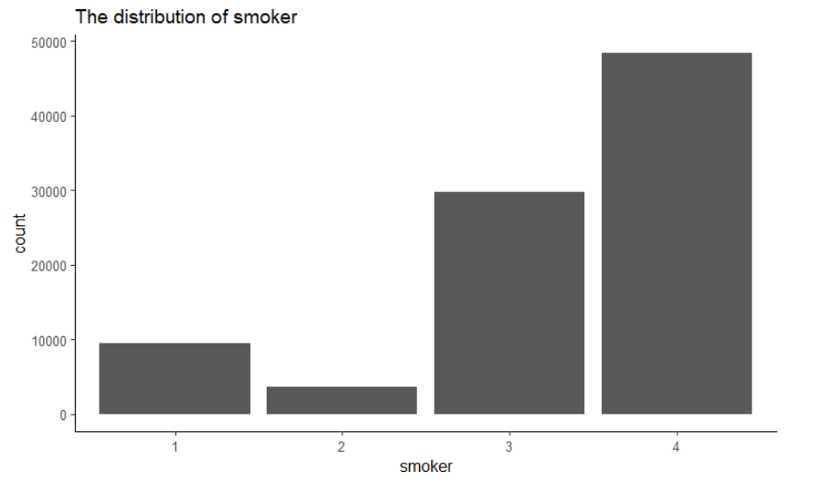
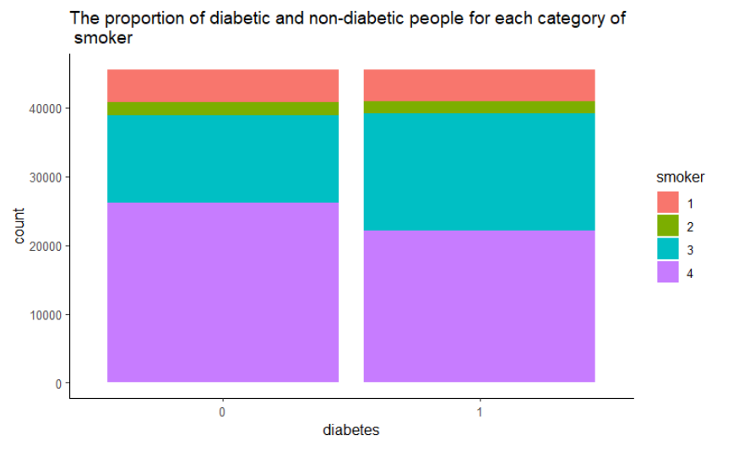
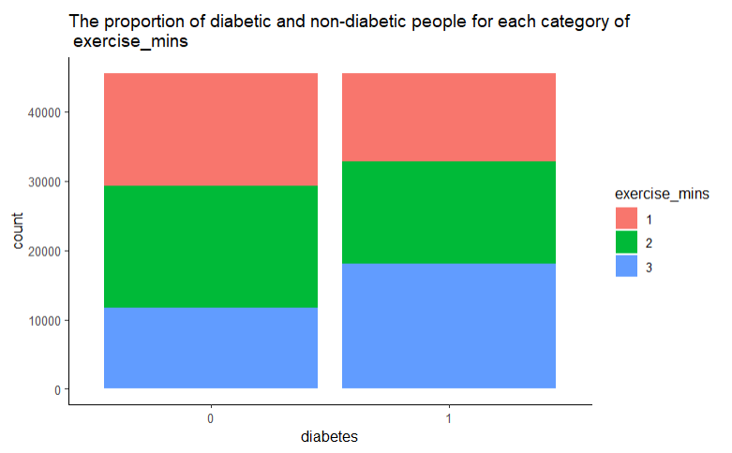
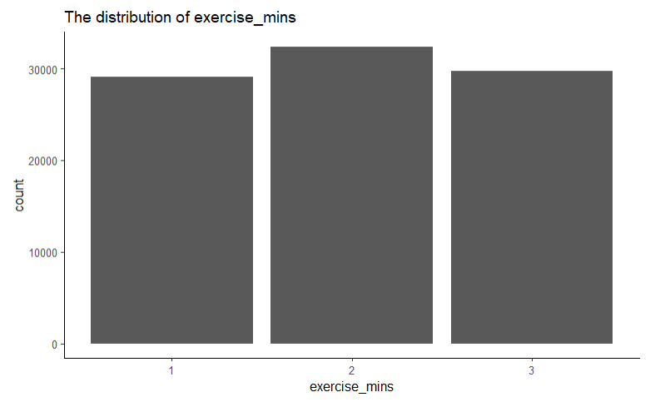
Plots for new variables:

Slide 8
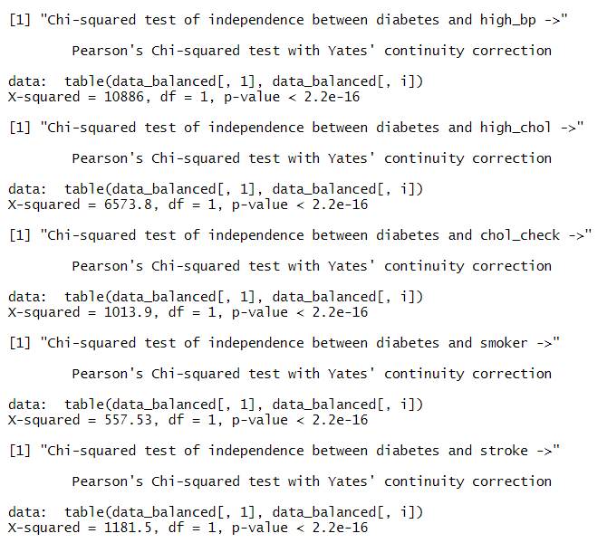
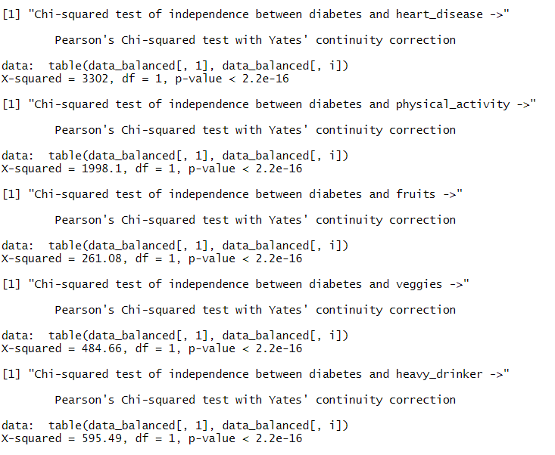
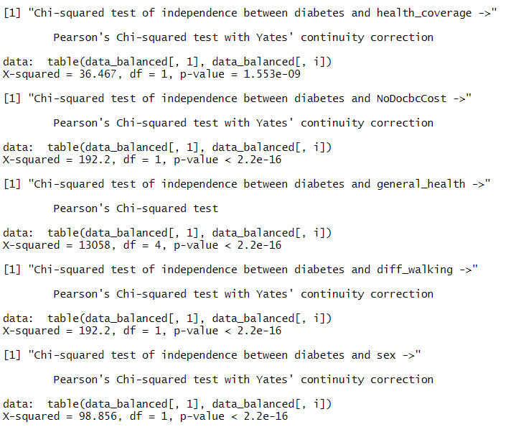
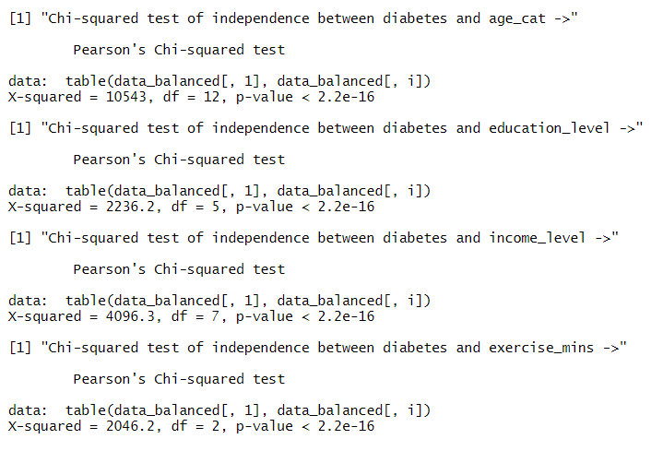
Hypothesis Testing:

Slide 9
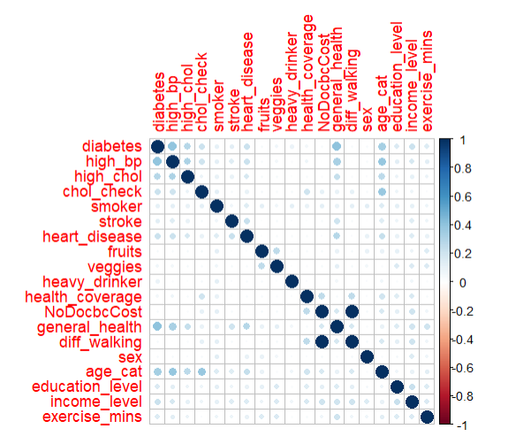
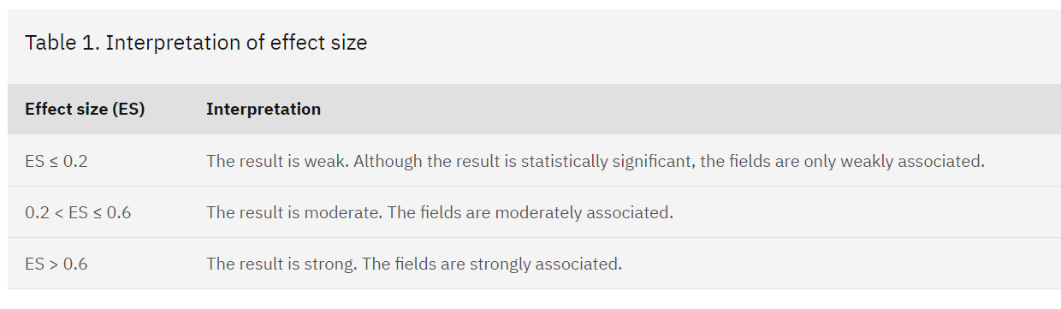
Check for multicollinearity Part 1:
We will use this general guideline to measure strength between factor variables. Provided by IBM. Cramér's V - IBM Documentation
Conclusions:
Remove NoDocbcCost because it is very strongly associated with diff_walking, and the Cramer’s V value was 1

Slide 10
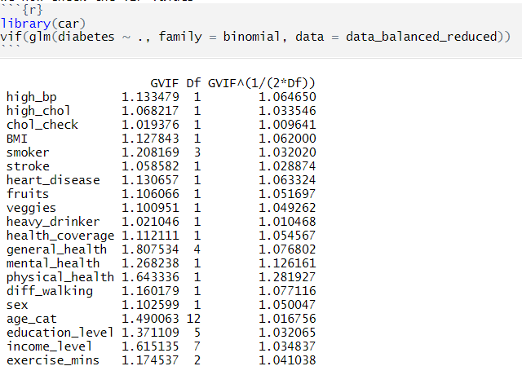
Check for multicollinearity Part 2:
Conclusion:
Generalized VIF values greater than 5 are an issue. However, because the generalized VIF values are less than 5. We do not have problematic amounts of collinearity.

Slide 11
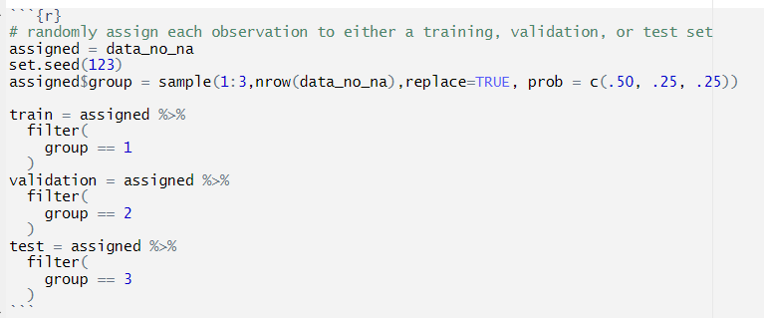
Perform Data Split:
50-25-25 Training, Validation, and Test sets. Note, we can do this because we have over 74,000 observations to work with,

Slide 12
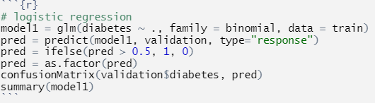
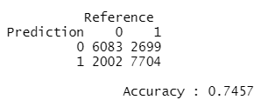
Logistic Regression:

Slide 13
Plans for spring break:
Finish training the rest of the models and interpreting them
Experiment with clustering the data using Gower’s distance and the Partition Around Medoids (PAM) clustering algorithm improve model accuracy?

